Slide 1

SUERF-OeNB conference
Policy Session
“Labor markets, wage setting and employment stability”
Eliana Viviano*
Banca d’Italia
Vienna, 18-19 June 2026
(*) The views expressed are those of the presenter and do not necessarily reflect those of Banca d’Italia or the Eurosystem

Slide 2
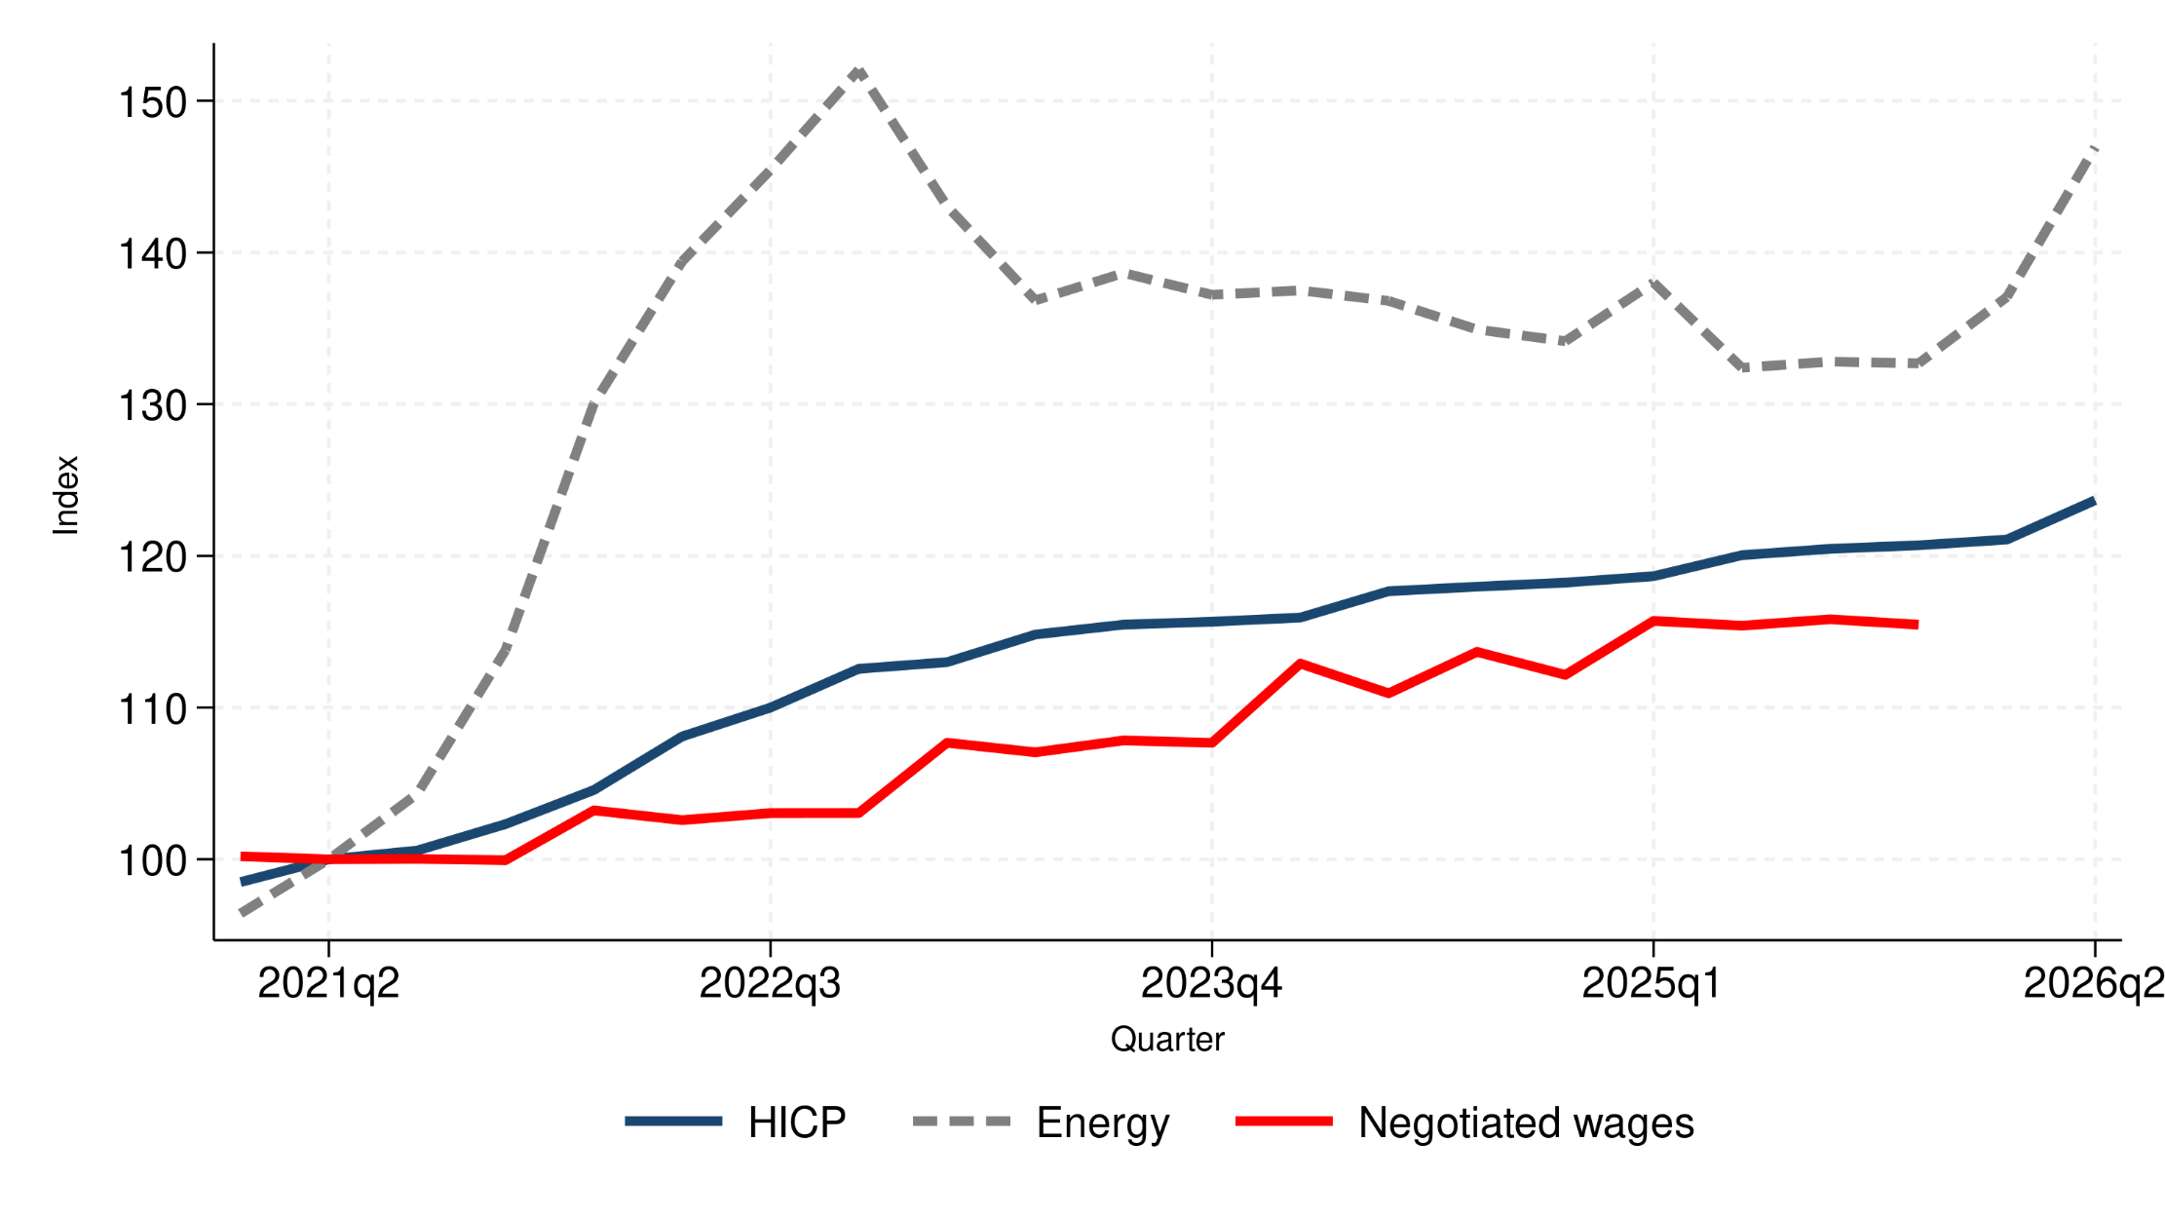
Euro area: the delayed response of wages allowed prices to slow down after the acceleration in 2022. Wages increased when other costs were already declining
Notes:
Broader context of the euro area labour market — and wages in particular.
Previous decade: great moderation, the current one is turning into a decade of large shocks and unusually weak real wage dynamics.
This sequence of shocks has changed the way we think about labour-market adjustment in the euro area.
In 2022, the increase in energy and intermediate-input costs was transmitted quite rapidly to consumer prices. It reflected, at least in part, the institutional structure of wage setting in the euro area.
This episode also showed something important: real wages in the euro area are indeed quite flexible, probably more flexible than many of us would have expected a decade ago.
From a monetary-policy perspective, this was helpful.
But this adjustment also had a cost. Loss of purchasing power. And this was not just a short-lived effect.

Slide 3
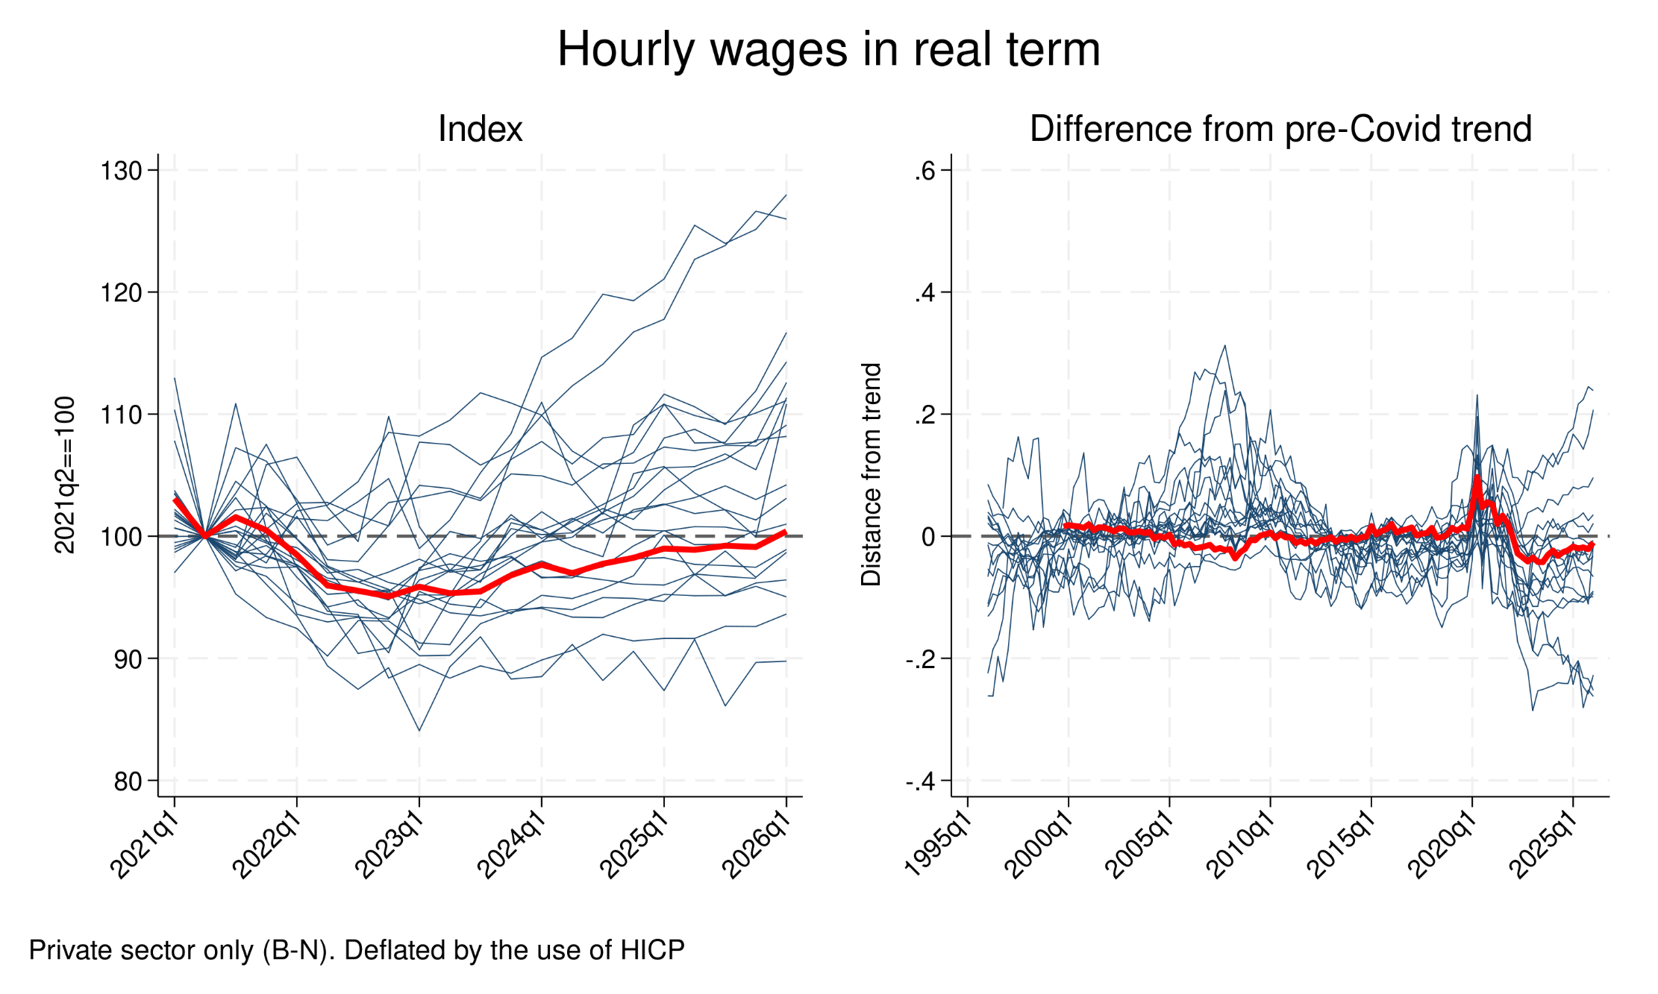
Real wages are back to pre-shock levels — but still below their pre-shock trend
Notes:
On average, real wages returned to their pre-shock level only at the end of 2025.
But with large heretogeneity across countries. Some small economies and Eastern europe countries very positive dynamics.
A recovery in levels is not the same as a recovery in the growth path.
This matters for macroeconomic dynamics. For many households, the shock did not simply create a temporary loss of purchasing power. It produced a persistent slowdown in expected income growth.
If households perceive that their real income prospects have weakened, consumption is likely to remain subdued. Demand side scare

Slide 4
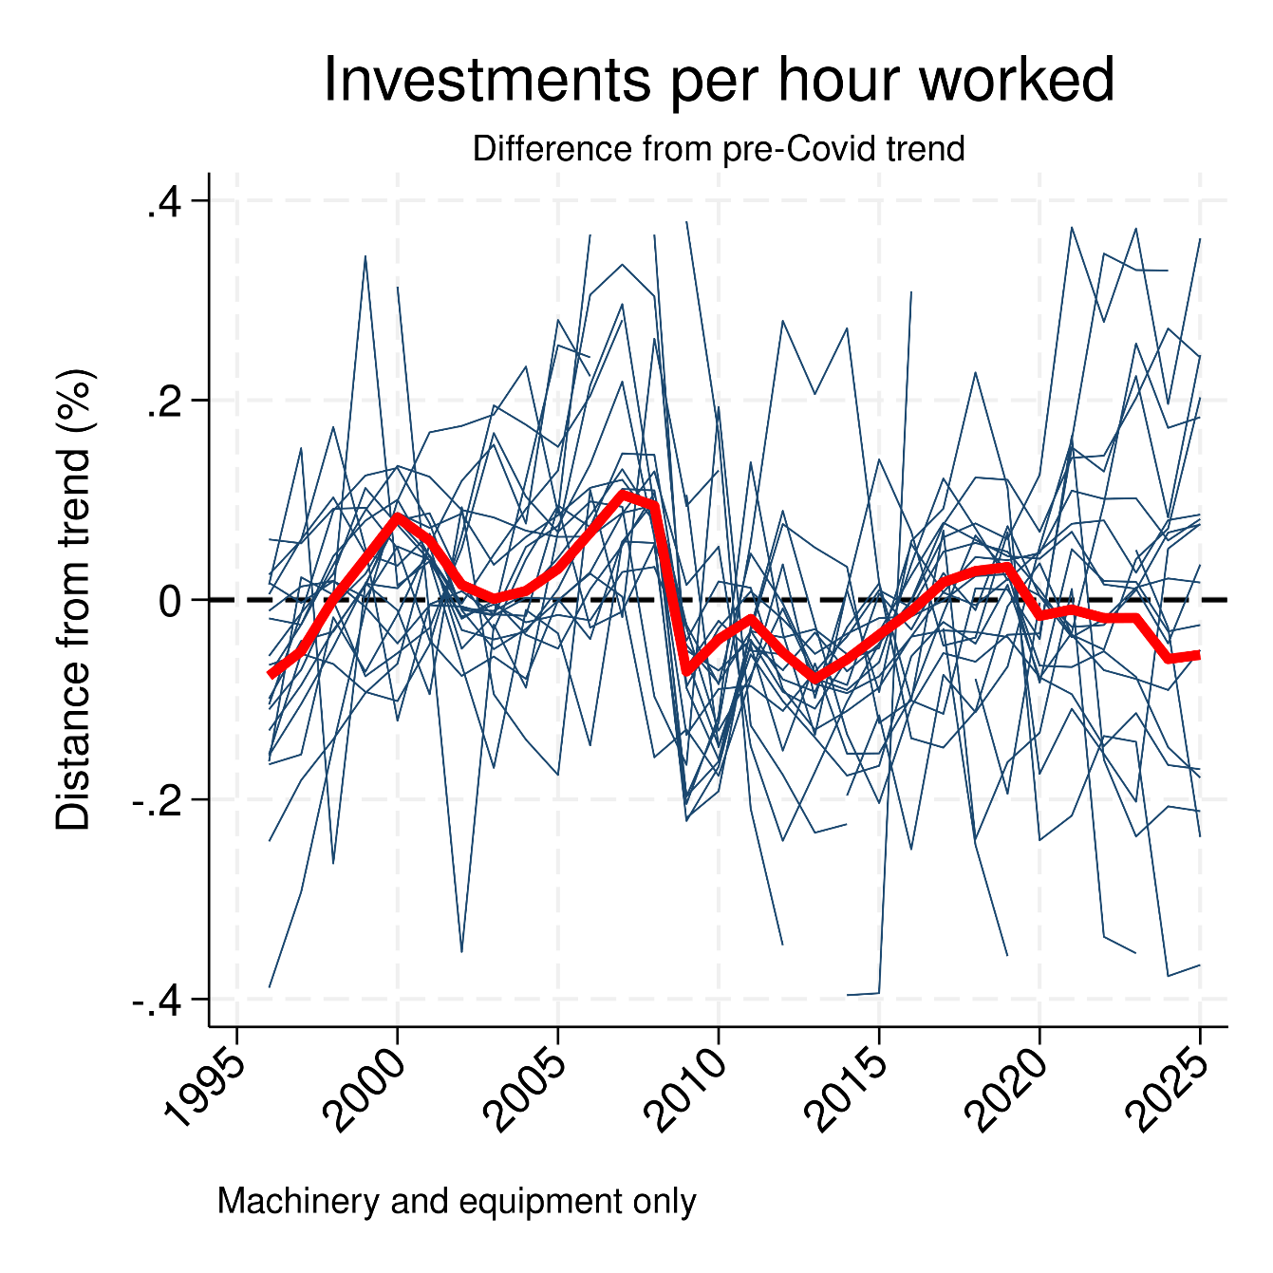
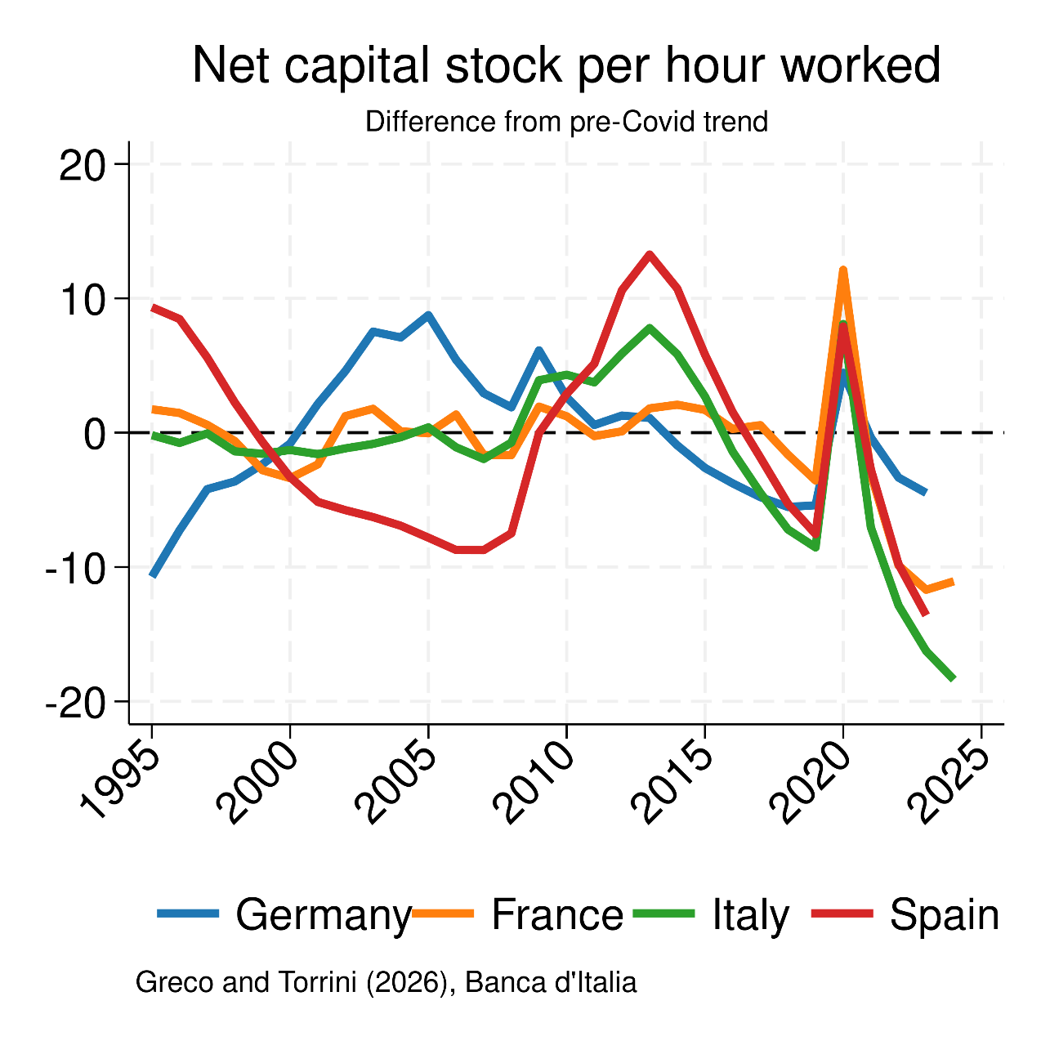
Relative input prices favoured labour hoarding over capital deepening
Notes:
Labour became relatively cheaper than other inputs.
This helped support employment.
But this resilience came with a cost. If labour becomes relatively cheaper, firms tend to substitute capital/intermediate goods/energy with labour.
This is exactly what we see. Investment per worker, or per hour worked, has remained weak compared with its pre-shock trend, although with significant cross-country heterogeneity.
And if we look at capital deepening in the four largest euro area economies, the picture is even clearer: it remains remarkably below trend.

Slide 5
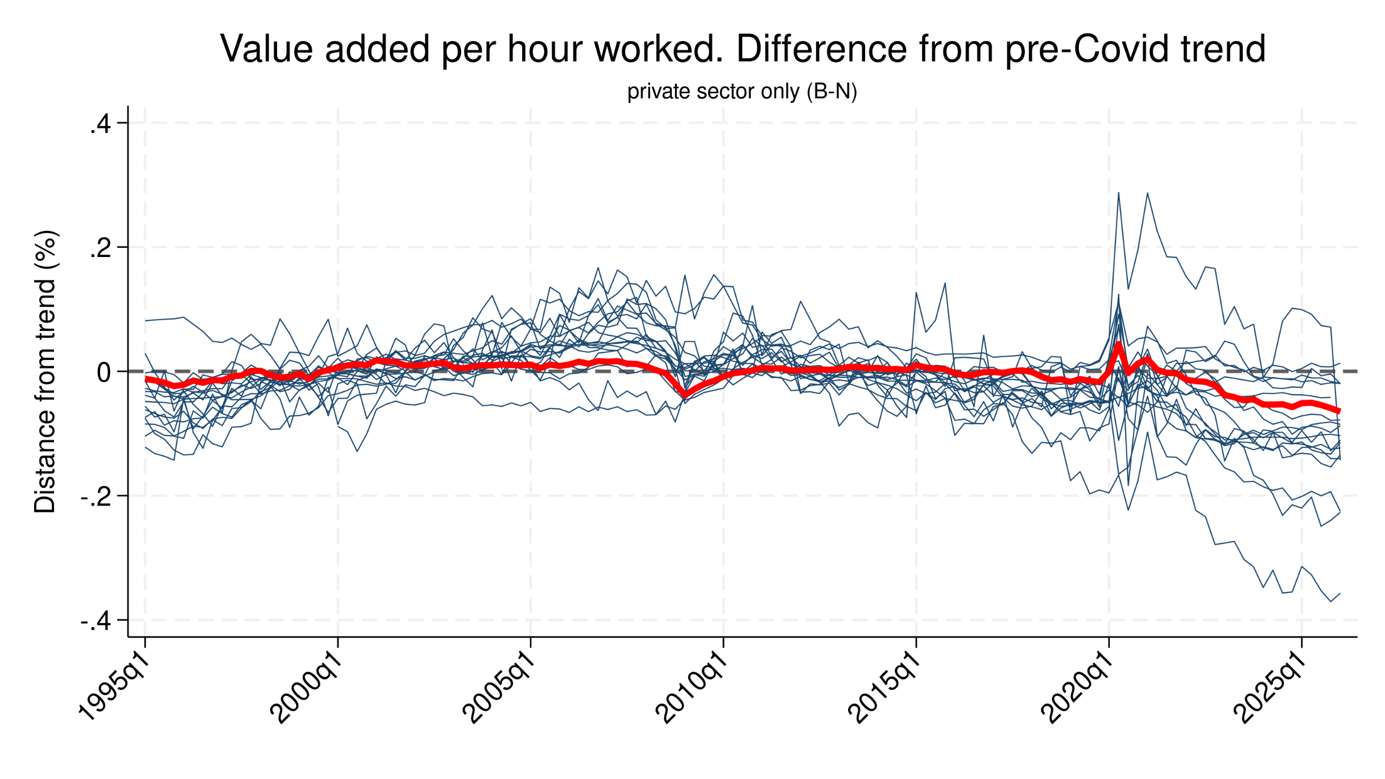
Employment resilience came with a productivity cost
Notes:
Labour productivity dynamics in the euro area have been weak, and remain below their long-term trend.
The concern is that this may not be only cyclical especially because employment is rather well protected in the EA, with high firing costs e instruments to avoid large adjustments.
If low investment per hour worked persists, the productivity loss can become more structural, reducing potential growth in the years ahead.
Supply side Hysteresis
This is a different hysteresis channel from the one usually discussed in the literature. The standard channel is demand-driven — weak demand discourages investment, which then depresses potential output (Fatás and Summers, 2018). Here the channel runs through relative factor prices: labour hoarding becomes the path of least resistance, and the longer firms rely on it instead of rebuilding capital, the more the productivity shortfall risks becoming structural rather than cyclical (Cerra, Fatás and Saxena, 2023). And there is recent evidence that this channel can be particularly persistent: Jordà, Singh and Taylor (2023) show that capital stock and TFP exhibit hysteresis effects recover much more slowly than employment does.

Slide 6
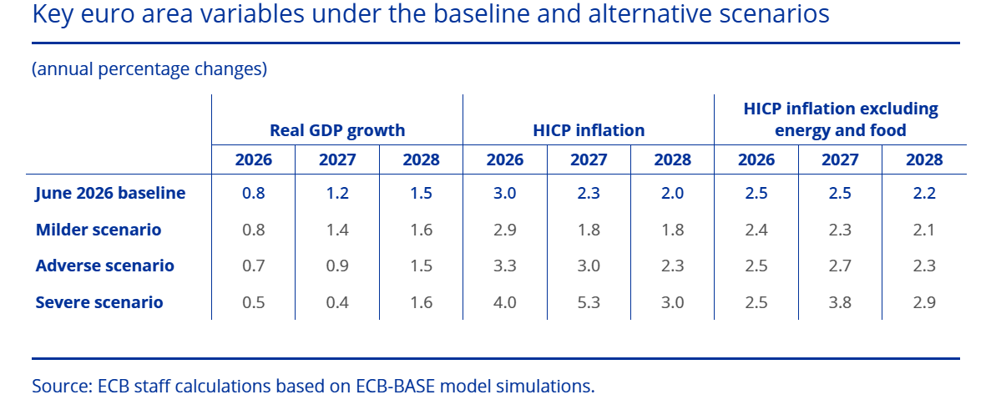
The euro area faces a second energy shock with real wages still fragile
Wage tracker: 2.6% in 2026
Notes:
And in this context, a new energy shock has arrived, before the euro area has fully absorbed the consequences of the previous one.
This shock is different from the 2022 gas shock.
The current shock is more centred on oil. Its transmission may therefore be different. But this does not mean that it is irrelevant. Oil still affects transport costs, production costs, food prices and inflation expectations.
Moreover, even after the peace agreement, the consequences for trade, supply chains and energy markets remain highly uncertain.
Early data for the first quarter of 2026, together with the latest Eurosystem projections, point to RENEWED PRESSURES on real wages. In the June 2026 macro projections, the ECB reports higher energy and food price assumptions and negative real wage dynamics in 2026 and 2027.
So the risk is that the same adjustment mechanism may operate again.

Slide 7
Policy challenges ahead
Employment resilience has been achieved partly through labour hoarding and weaker capital deepening, also supported by employment protection and policy measures.
If K/L remains weak, productivity (and wages) may stay below trend for longer.
The risk is that a cyclical response becomes a supply-side scar.
Cross-country heterogeneity matters: the same shock may deepen divergence within the euro area, making policy design more difficult.
AI could be a force for convergence — but also for divergence if adoption is uneven.

Slide 8
Thank you
(eliana.viviano@bancaditalia.it)

