Slide 1
Quantitative Easing in a
Heterogeneous Monetary Union
Nastasia Henry
Aix-Marseille Université
53rd OeNB Annual Economics Conference · Vienna, June 2026
Conference theme: Monetary policy trade-offs in a heterogeneous currency area

Slide 2
MOTIVATION
One Policy — Two Very Different Households and Countries
“Imagine two households in the euro area. One in Germany, one in Greece. The ECB announces a large-scale bond-buying programme — the same policy, for everyone, at the same time. But do these two households benefit equally?”

Slide 3
MOTIVATION
One Policy — Two Very Different Households and Countries
Heterogeneous transmission of Monetary Policy that depends on : who you are where you live
Within-country heterogeneity – different households within a country
Cross country heterogeneity – debt structure:
            debt-to-GDP,
            maturity of the debt (short-term versus long-term)
            liquidity

Slide 4
FRAMEWORK
Two Building Blocks
Local Projections — Jordà (2005), impulse responses to QE shocks across heterogeneous countries
1
Two-country TANK model — core vs. periphery, optimisers & hand-to-mouth households
2
Financial frictions — Kiyotaki & Moore (2016) resaleability constraint on long-term bonds
Key innovation: Bond resaleability = ϕ varies across countries — not all bonds are equally liquid. Core bonds trade freely; periphery bonds are illiquid. This governs how much QE actually reaches the real economy.
▶ Presented today
The resaleability parameter ϕ is the key lever — it determines how much of QE’s force reaches investment and output

Slide 5
MODEL
The Portfolio Rebalancing Channel
QE
→
↓ long-term yield rˡ
→
Portfolio rebalancing
→
↑ Investment · Capital · Output
Core — liquid bonds (ϕ = 0.8)
Periphery — illiquid bonds (ϕ = 0.6)
Bonds easy to sell or use as collateral
Households freely rebalance toward capital
Strong effects on investment & output
Households forced to keep bonds on balance sheet
Rebalancing toward capital is constrained
Limited effects on investment & output
ϕ — bond resaleability — governs the amplitude of portfolio reallocation

Slide 6
RESEARCH QUESTION
Does Heterogeneity Shape the Transmission of QE? If yes, what are the effects of QE?
Scenario 1
Scenario 2
Scenario 3
Benchmark
Within-country
Cross-country
Symmetric monetary union
No heterogeneity
Different share of
hand-to-mouth households
Different debt structure
(ratio, maturity, liquidity)
▶ Presented today
▶ Presented today
Framework: Two-country TANK + Financial frictions (Kiyotaki & Moore, 2016) + Local Projections (Jordà, 2005)

Slide 7
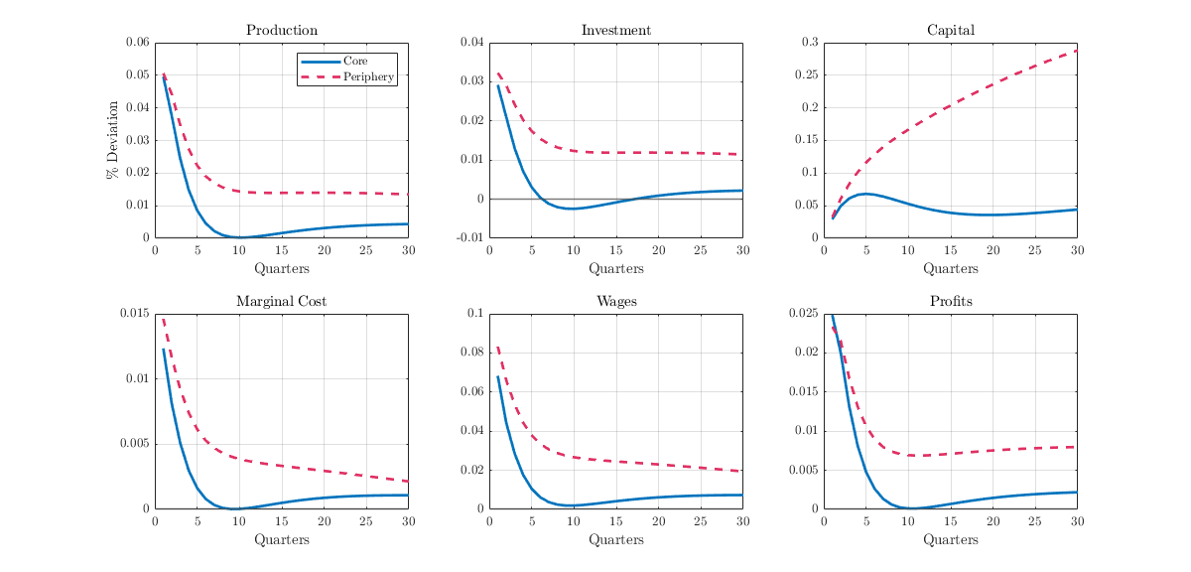
SCENARIO 2 — WITHIN-COUNTRY HETEROGENEITY
More Hand-to-Mouth → Stronger QE Response
↑ η ⟹ stronger output response + larger short-run inequality compression

Slide 8
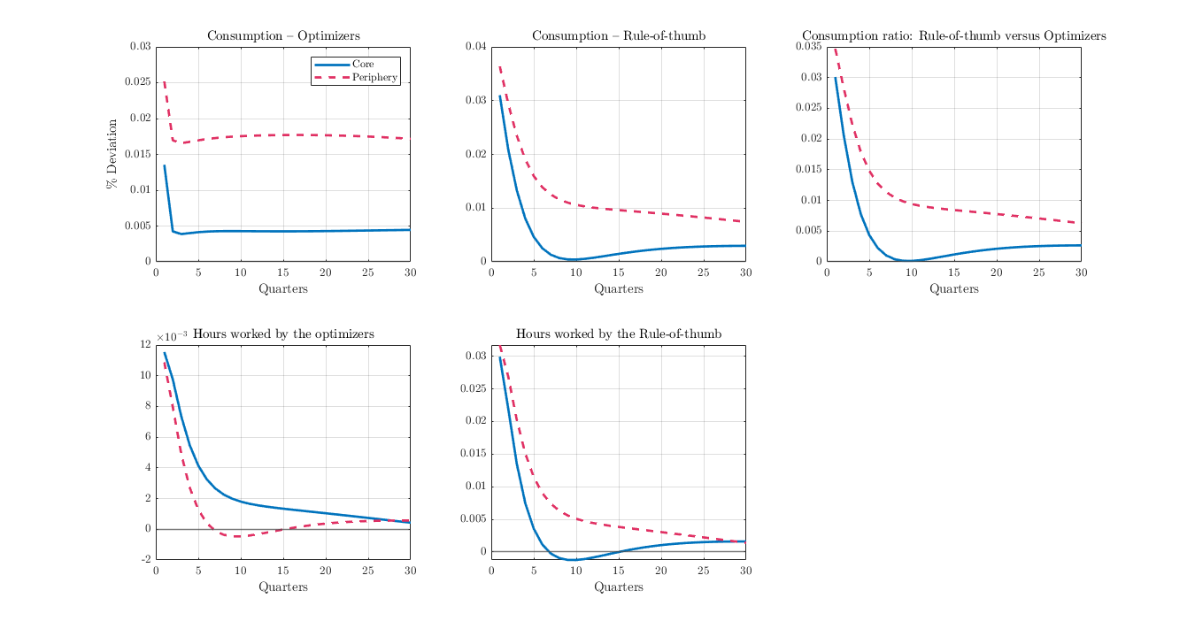
SCENARIO 2 — WITHIN-COUNTRY HETEROGENEITY
More Hand-to-Mouth → Stronger QE Response
↑ η ⟹ stronger output response + larger short-run inequality compression

Slide 9
SCENARIO 2 — WITHIN-COUNTRY HETEROGENEITY
More Hand-to-Mouth → Stronger QE Response
QE → ↓ rˡ
→ Labour demand & supply ↑
→ HtM wages ↑
→ Immediate spending
→ Aggregate demand ↑
Core (η = 0.25)
Periphery (η = 0.45)
Few hand-to-mouth households
Most households smooth consumption intertemporally
Moderate aggregate demand response
Smaller short-run inequality compression
More hand-to-mouth households
Income gains translate immediately into spending
Stronger aggregate demand response
Larger short-run inequality compression ✓
↑ η ⟹ stronger output response + larger short-run inequality compression

Slide 10
SCENARIO 3 — CROSS-COUNTRY HETEROGENEITY
Debt Structure Determines Who Benefits More
Calibration (based on Eurozone data)
Parameter | Core | Periphery
Debt-to-GDP | 80% | 120%
ST / LT ratio (ϑ) | 0.25 | 0.40
Bond liquidity (ϕ) | 0.80 | 0.60

Slide 11
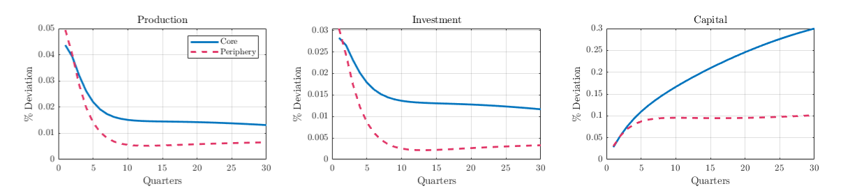
SCENARIO 3 — CROSS-COUNTRY HETEROGENEITY
Debt Structure Determines Who Benefits More

Slide 12
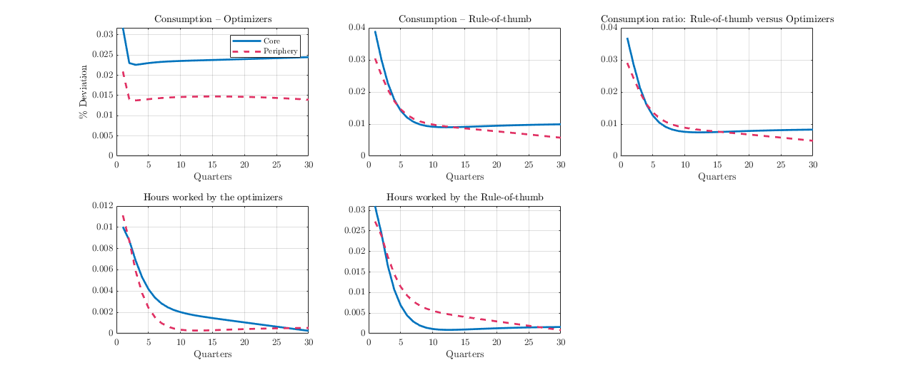
SCENARIO 3 — CROSS-COUNTRY HETEROGENEITY
Debt Structure Determines Who Benefits More

Slide 13
SYNTHESIS
Two Channels — Opposite Directions
Within-country channel
Cross-country channel
Favours the periphery
Favours the core
Driven by hand-to-mouth share η
↑ η → stronger demand multiplier
↑ η → larger inequality compression
Periphery (η = 0.45) benefits more
Driven by bond liquidity ϕ and maturity ϑ
↑ ϕ → larger portfolio reallocation
↓ ϑ → reallocation flows into capital
Core (ϕ = 0.8, ϑ = 0.25) benefits more
vs.
Which dominates? Depends on the relative size of η, ϕ, and ϑ — next on the research agenda

Slide 14
POLICY IMPLICATIONS
Uniform QE is Not Neutral
1
Internalise cross-country asymmetries
The allocation of purchases across country bond markets matters — not just total volume. Uniform programmes are not distribution-neutral.
2
Prefer targeted, calibrated measures
The PEPP’s flexible reinvestment mechanism is a step in this direction. This model provides a theoretical foundation for heterogeneity-aware instrument design.
3
Coordinate with fiscal authorities
The periphery’s disadvantage reflects debt composition and bond market depth — structural features monetary policy alone cannot address.
Symmetric logic to the TPI (2022): if tightening can fragment, easing can diverge too

Slide 15
CONCLUSION
Heterogeneity Shapes QE — Both Ways
①
QE is expansionary — but asymmetrically so
Within-country heterogeneity (η) amplifies output gains and inequality reduction more in the periphery.
②
Cross-country heterogeneity amplifies divergences
Bond liquidity (ϕ) and debt maturity (ϑ) give the core a structural advantage via the portfolio rebalancing channel.
③
Policy design should be heterogeneity-aware
Uniform large-scale programmes risk widening the core–periphery gap. Targeted, calibrated instruments matter.
Next: external positions (trade balance, NFA) + empirical validation via Local Projections on EMU data
Should the ECB explicitly internalise cross-country asymmetries when calibrating asset purchases?

Slide 16

Many thanks!
Link to my website with the last version of the paper

