Slide 1
Panel on: Housing markets, mortgages and regional differences.
John Muellbauer
OENB-SUERF Annual conference
18 June 2026

Slide 2
Cross-country institutional diversity : matters for both monetary transmission and financial stability.
Risks posed by monetary union due to institutional differences in credit, tax systems, land use and housing and labour markets (Maclennan et al. (1998), updated Muellbauer (2022)).
Transmission via house building, consumer spending & amplifying feedbacks. Key issues:
  Housing loans collateralised or covered by collective insurance?
  Fixed vs floating rate mortgages?
  Mortgage interest tax relief?
  Home equity withdrawal?
  Market value linked property tax?
  Owner-occupation rate, rent regulation.
  Quality and setting of BBMs.
  Structure of banking system: complexity, interconnectedness, maturity mis-match.
  Other financial regulation & bank supervision: e.g. capital requirements on banks, stress test regime.
Cross-country panel evidence on effectiveness of macropru:
  fixed effects cannot capture structural differences in 56 (or 119) country panels, Muellbauer (2024).

Slide 3
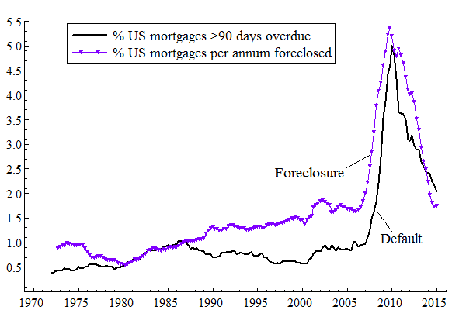
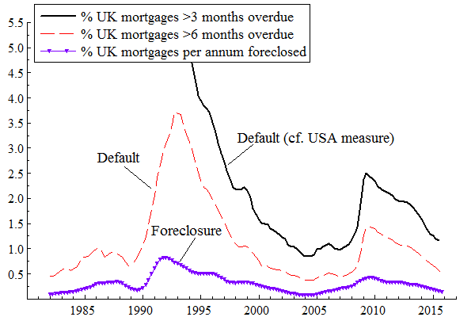
Extrapolative expectations increase amplification; floating interest rates are double-edged.
Housing market participants often extrapolate past appreciation (evid. Duca, Muellbauer & Murphy (2021), section 4.3)
Expectations affected by:
  Market related property tax: automatic tax rise with rising values cuts prospective returns.
  Gearing (high LTV), since gearing amplifies returns. And gearing depends on loan standards and hence macropru. Mortgage interest tax relief incentivises high gearing.
  Path dependence: encouraged by history of large amplitude house price swings.
Floating rates can destabilise with interest rate shock (UK 1990-93); but stabilise by speedily transmitting policy easing (UK GFC vs. US GFC), Aron & Muellbauer (2016).

Slide 4
Macropru should manage the credit cycle: via lending standards, interacting with NPLs and housing.
Macropru and lending standards:
  Borrower-based measures include ceilings on LTVs, LTIs, DSTIs;
  Lender-based measures include capital requirements and liquidity standards.
Connection - lending standards and the credit cycle, Muellbauer (2022) (evid., France):
  Lending standards are an important driver of real estate prices, credit growth, consumer expenditure and residential investment (hence economic activity); and of NPLs.
Connection between NPLs and lending standards:
  Higher NPLs lead to tighter lending standards (amplifying the downturn in the economy).
Interest rates affect NPLs and hence lending standards:
  Interest rates are key drivers of real estate prices, credit growth, consumer expenditure and residential investment (hence economic activity); and of NPLs.
Close interconnection between monetary policy and macropru policy in real estate context: insufficient attention in modelling and policy-making.
Contrast:
  sophisticated appreciation of real estate in the credit cycle at the ESRB and central banks’ financial stability teams and comparative under-emphasis by monetary policy modelling teams.

Slide 5
The new EA macroprudential framework and real estate.
Given that monetary policy is made in Frankfurt:
  Devolved management of macropru helps manage each country’s credit cycle and compensate for risks posed by diversity.
Supra-national bodies (the ESRB, the ECB, the EBA) and national central banks and regulators must co-ordinate:
  Apart from principles of democratic control and subsidiarity, institutional heterogeneity makes this a functional necessity.
Welcome push from the supra-national bodies for:
  Improved cross-country data monitoring across CRE and RRE.
  New instruments e.g. sectoral systemic risk buffers.
  Minimum standards on the legal perimeter for borrower-based macropru measures.
The current system where the ESRB issues warnings of risk build-up, recommendations for macropru tightening and follow-up checks on implementation, is broadly working:
  But with better data it could improve.
Macroprudential policy, esp’y using BBMs, raises distributional and governance issues.

Slide 6
Distributional issues, granular data and ABMs.
Survey of recent empirical research on distributional implications on use of borrowed-based tools (Muellbauer (2024), section 5.3).
Politicians/Media worry: tighter BBMs (i.e. lower LTV or DSTI ceilings, higher amortisation reqrments) cut owner-occupation, increase inequality, lower welfare.
If these are your concerns:
  Eliminate/limit mortgage interest tax deduction; found highly regressive (OECD 2021)
  Make property taxes proportional or progressive, linked to market values.
  Use split rate taxes to tax land more heavily than buildings, Muellbauer 2023.
  Reform land use zoning or planning to increase housing supply.
  Reduce transfer taxes.
  Soften the short-term impact of BBMs through escape clauses.
Analysis of granular data:
  Use systems approach with a complete capture of dynamic interactions among: households (renters and owner-occupiers); investors; landlords; banks, firms; fiscal authority; central bank and/or financial regulator.
  New book (open access) by Jagoda Kaszowska-Mojsa : how ABM approach illuminates distributional implications.

Slide 7
CGFS (2023), BIS:
Study of macroprudential policy in 14 countries.
Consistency across housing-related policies: helps mitigate boom-bust cycles in housing markets.
  e.g. Tax, planning and land supply policies all have a decisive influence on demand-supply imbalances in the housing market.
  Macroprudential policies complement these policies.
Governance arrangements: an important influence on policy effectiveness.
Mitigate inaction bias: prioritise tools to meet objectives that require no adjustment.
  e.g. Floors on loss-given-default parameters; minimum risk weights; appropriately designed income-based borrowing limits.
  Help maintain resilience in housing market upswings, and sharp interest rate shocks.
Openness about cost-benefit trade-offs: fosters LT support for macropru policies.
  Communication re costs, benefits, uncertainties of measurement and how these informed policy decisions - maintains support when memory of housing crises fade.

